Slide 1

Traffic Route Planning for Accident Prediction
Caoxi Zhang
Computer Science Project 07/12/2022

Slide 2








Outline
Introduction
Issues & Solution
Analysis
Future Work
What’s the machine learning in IoT
The applications in the smart transportation
The current issues and my solution
The analysis of the dataset
The measurement of the results
Future achievements goals

Slide 3


Introduction
Machine learning in Internet of Things (IoT)^{[1]}
Application
Navigation/Route optimization
Intelligent traffic light
Parking systems
Road conditions detection
Physical Objects with sensors
Machine learning algorithms making decision or prediction based on data
Technologies connecting and exchanging data

Slide 4
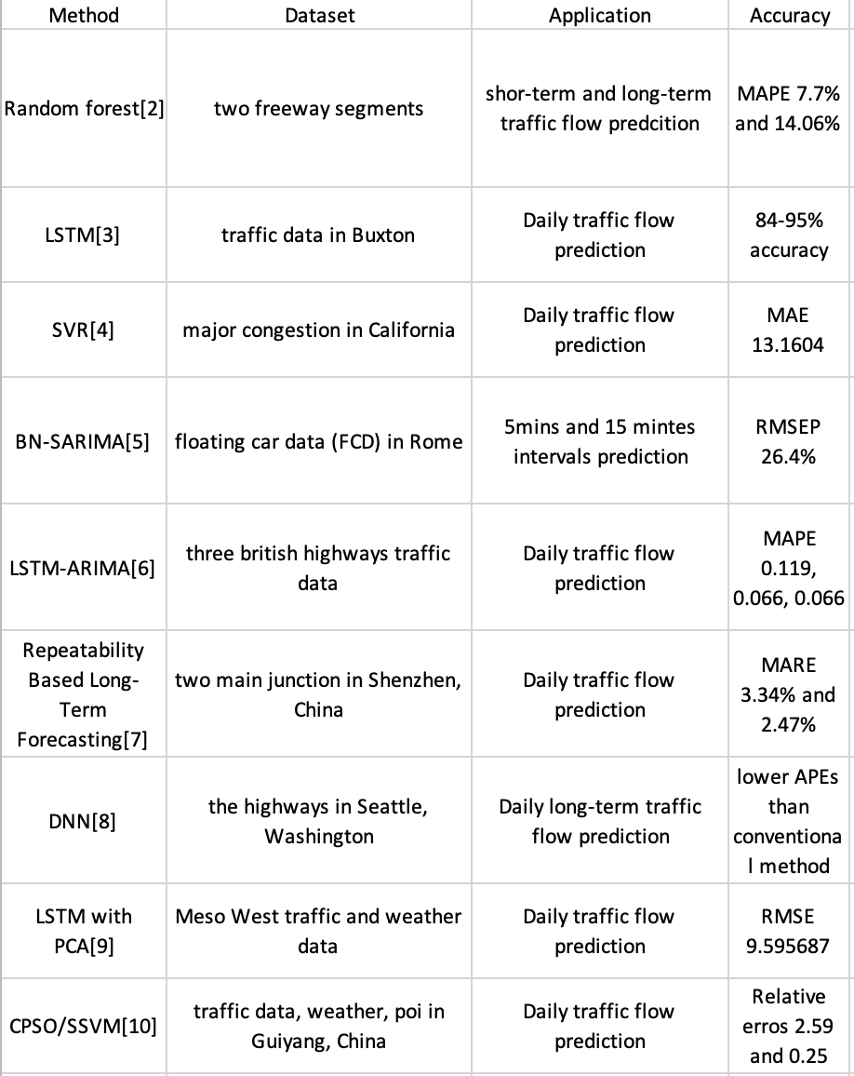
Literature Survey
Mainstream researches in smart transportation area

Slide 5

Issues
In the UK^{[11]}
Every 16 minutes, someone is killed or seriously injured on the road
In London^{[12]}
Over 23,000 car collisions were recorded in 2021

Slide 6


Issues
Current navigation apps
Route optimization focus on time efficiency
No or few warnings for high accident risk roads

Slide 7

Solution Traffic Route Planning for Accident Prediction
Accident prediction using machine learning
Safe and time efficient route optimization

Slide 8

Project Route Map

Slide 9
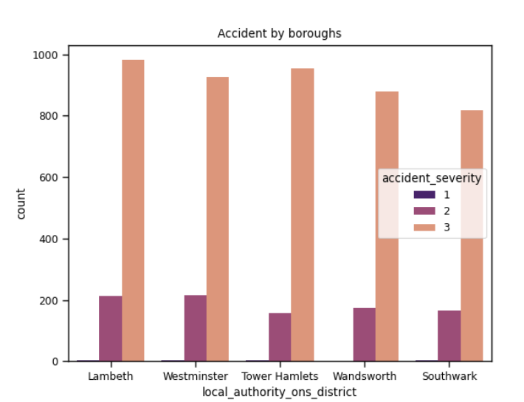
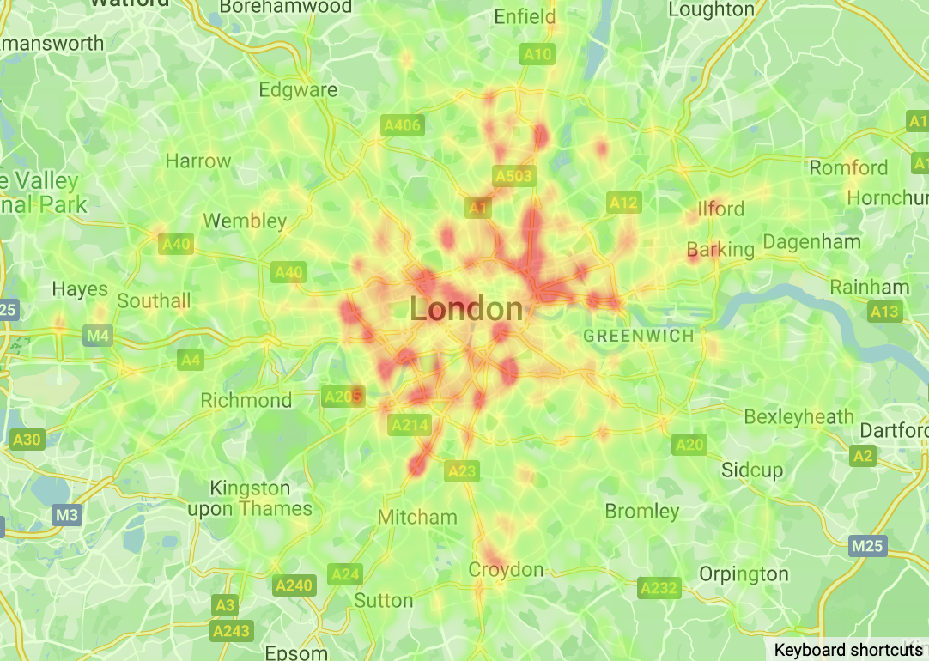
Accident data in London in 2021^{[13]}
Fig1. choropleth graph showing the occurrence of
accidents
Fig2. bar chart showing the occurrence of
accidents by boroughs

Slide 10
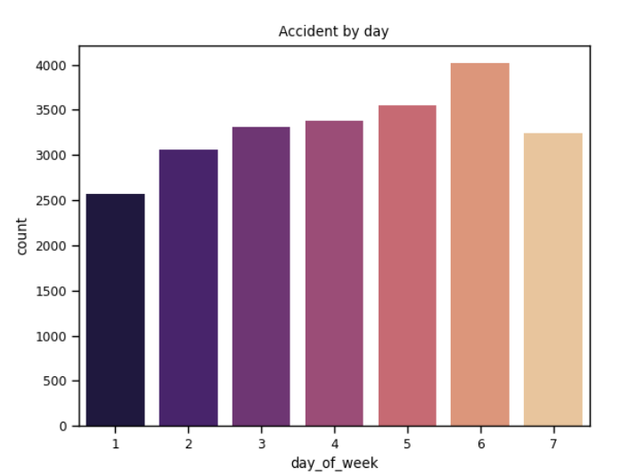
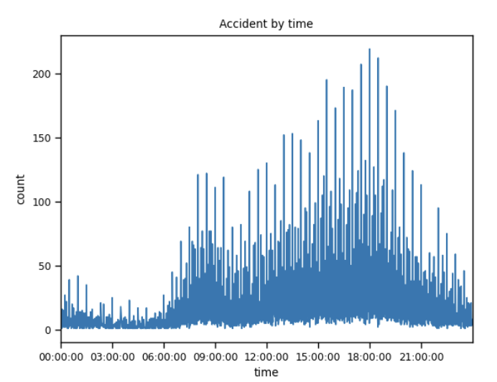
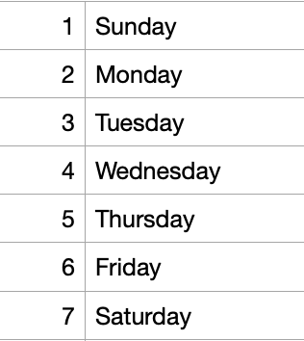
Accident data in London in 2021
Fig3. bar chart showing the occurrence of
Accidents during the week
Fig4. time series graph showing the occurrence of
accidents during the day
Notes:
6:friday

Slide 11
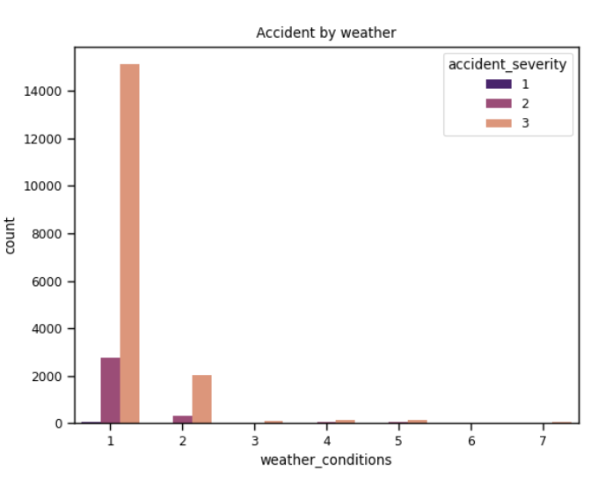
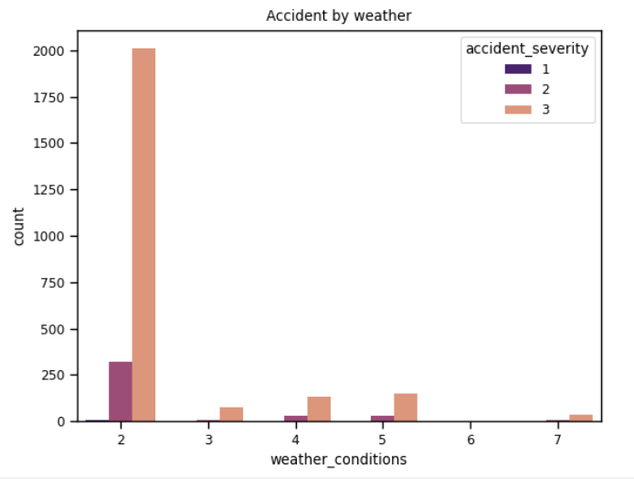
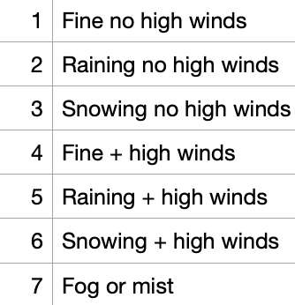
Accident data in London in 2021
Fig5. bar chart showing the occurrence of
accidents under different weather conditions
Fig5. bar chart showing the occurrence of
accidents under different (bad) weather conditions

Slide 12
Algorithms
Classification
Support Vector Machine (SVM/SVR)
Decision trees
Bayesian Additive Regression Tree (BART)
Area A
Area B
Area C
start
end

Slide 13


Performance metrics
Accuracy
The number of correct predictions divided by the total number of predictions
Confusion matrix^{[14]}
 |  | Predicted
 |  | Accident | No accident
Ground Truth | Accident | TP | FP
 | No accident | FN | TN

Slide 14


Future Work
More features
Applying
Applying the algorithms
Training
Training models
Evaluating
Evaluating the results
Drivers
Drivers’ ages/genders
Vehicle
Vehicle types
Road
Road speed limits

Slide 15
References
[1] Zantalis, F., Koulouras, G., Karabetsos, S. and Kandris, D. (2019). A Review of Machine Learning and IoT in Smart Transportation. Future Internet, 11(4), p.94. doi:10.3390/fi11040094.
[2] Hou, Y., Edara, P. and Sun, C. (2015). Traffic Flow Forecasting for Urban Work Zones. IEEE Transactions on Intelligent Transportation Systems, 16(4), pp.1761–1770. doi:10.1109/tits.2014.2371993.
[3] Majumdar, S., Subhani, M.M., Roullier, B., Anjum, A. and Zhu, R. (2020). Congestion Prediction for Smart Sustainable Cities using IoT and Machine Learning Approaches. Sustainable Cities and Society, p.102500. doi:10.1016/j.scs.2020.102500.
[4] Chen, Y., Chen, H., Ye, P., Lv, Y. and Wang, F.-Y. (2022). Acting as a Decision Maker: Traffic-Condition-Aware Ensemble Learning for Traffic Flow Prediction. IEEE Transactions on Intelligent Transportation Systems, 23(4), pp.3190–3200. doi:10.1109/tits.2020.3032758.
[5] Fusco, G., Colombaroni, C., Comelli, L. and Isaenko, N. (2015). Short-term traffic predictions on large urban traffic networks: Applications of network-based machine learning models and dynamic traffic assignment models. 2015 International Conference on Models and Technologies for Intelligent Transportation Systems (MT-ITS). doi:10.1109/mtits.2015.7223242.
[6] Lu, S., Zhang, Q., Chen, G. and Seng, D. (2020). A combined method for short-term traffic flow prediction based on recurrent neural network. Alexandria Engineering Journal. doi:10.1016/j.aej.2020.06.008.
[7] Hou, Z. and Li, X. (2016). Repeatability and Similarity of Freeway Traffic Flow and Long- Term Prediction Under Big Data. IEEE Transactions on Intelligent Transportation Systems, 17(6), pp.1786–1796. doi:10.1109/tits.2015.2511156.
[8] Qu, L., Li, W., Li, W., Ma, D. and Wang, Y. (2019). Daily long-term traffic flow forecasting based on a deep neural network. Expert Systems with Applications, [online] 121, pp.304– 312. doi:10.1016/j.eswa.2018.12.031.
[9] Mingzhou, W., Shan, T., Chao, C. and Jiandan, Z. (2020). Short-time traffic flow forecast with weather characteristics. [online] IEEE Xplore. doi:10.1109/CCNS50731.2020.00039.
[10] Liu, F., Ma, X., An, X. and Liang, G. (2020). Urban Traffic Flow Prediction Model with CPSO/SSVM Algorithm under the Edge Computing Framework. Wireless Communications and Mobile Computing, 2020, pp.1–11. doi:10.1155/2020/8871998.
[11] Trust in London (2022) Available at: https://www.trustforlondon.org.uk/
[12] Brake (2022) Available at: https://www.brake.org.uk/
[13] Road Safety Data (2022) Available at:https://www.data.gov.uk/dataset/cb7ae6f0-4be6-4935-9277-47e5ce24a11f/road-safety-data
[14] Performance Metrics in Machine Learning [Complete Guide] (2022) Available at: https://neptune.ai/blog/performance-metrics-in-machine-learning-complete-guide

